Slide 1

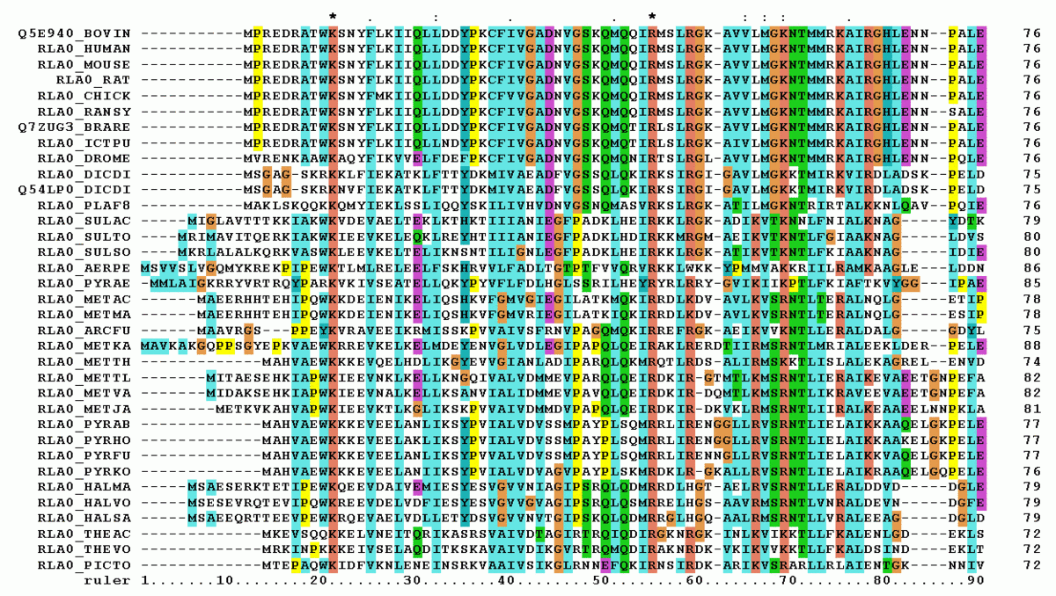
ML2223-15 Approve Prediction of Multisequence Learning
Prepared By Group 15:
Poonam Paraskar
Ankita Talande(1427349)
Pratik Desai

Slide 2
Index
Introduction
Methodology
Hierarchical Temporal Memory
Spatial Pooler and Temporal Memory
Program Flow – Training Phase
Program Flow – Prediction Phase
Output Screenshot
Conclusion

Slide 3
Introduction
Multisequence learning is a machine learning approach in which a model learns temporal patterns of sequences one by one during the course of the experiment and provides the matching sequences as the predicted output. It is a form of sequential learning in which the model learns from multiple sequences over time, instead of just one sequence.
In this approach, a list of sequences with double data-type are stored in an excel file, which is used as the input sequence file for the model to train itself by storing these values in temporal memory. The model then predicts the next element of the predicted sequence based on the patterns learned from the previous sequences. The sequences are typically represented as Sparse Distributed Representations (SDRs), which are similar to binary vectors.
The aim of multisequence learning is to demonstrate how to learn sequences using a predictor's own method and save all the sequences as a Dictionary object, which is then considered as the training data. This allows the model to learn from a variety of sequences and generalize its predictions to new sequences it has not seen before.

Slide 4
Methodology
GetInputFromTextFile( ):
Team has implemented GetInputFromTextFile() method to take the inputs from the Text file. We have tried 2 approaches to split the multiple input sequences by using comma ‘,’ to separate each digit of the input sequence and using special character at the end of each sequence for splitting it from other input sequences. In this case we used semi-colon ‘;’ to split. The significant issue we faced by using this approach is we had to add both comma ‘,’ and semi-colon ‘;’ at the end of each input sequence, which is not a feasible solution and by which text file also looks inappropriate.
To resolve issue, we faced in the first approach we used regular expression to split multiple sequences based on detecting the enter ‘/r/n’. Using this approach wherever we added enter for next input, is getting detected by our regular expression logic. For this we had to read all the rows together using reader.ReadToEnd( ) method and then split it by detecting the enter keyword. This can cause an issue in real time working environment.
GetInputFromCsvFile( ):
Team has implemented GetInputFromCsvFile( ) method to take the inputs from the CSV file. CSV stands for "Comma-Separated Values". In a CSV file, each line represents a row of data and each field within a row is separated by a comma. CSV files are simple and widely supported, making them a popular choice for data exchange between different systems and applications.The problem with CSV file is we need to add one non double character at end of each row to terminate the row/sequence and take the next sequence. This can cause an issue in real time working environment.

Slide 5
GetInputFromExcelFile( ):
In the GetInputFromExcelFile( ) method we are using .xlsx file type to take the input sequences. Which are referred as training data sequences. Here we overcame the issues of the previous methods GetInputFromCsvFile() and GetInputFromTextFile() where we need to add any non-double value to terminate the row/sequence and to jump to the next row/sequence and any special in case of text file to jump over the next input sequence. To implement this feature we used the string.IsNullOrWhiteSpace( ) property.
GetSubSequencesInputFromExcelFile( ):
We have implmented the GetSubSequencesInputFromExcelFile() method to take the subsequence test input from the .xlsx file. We are passing the TestSubSequences to the SubSequences list of type double. After reading all the TestSubSequences we are returning SubSequences.
Accuracy Logs:
We have used StreamWriter( ) class to create the file. If the file exists, It can be overwritten or appended to. If the file does not exist, this constructor creates a new file. The true flag appends to the file instead of overwriting it. Here we are generating logs for sequenceKeyPair.Key and accuracy. Ex. Sequence: 1 is having accuracy 30%

Slide 6
Hierarchical Temporal Memory
In this project we are using - Scalar Encoder
1. The main purpose for scalar encoder is to encode numeric or floating-point value into an array of bits, where the output has 0’s with an adjacent block of 1’s. The location of the block of 1’s varies continuously depending on the input value.

Slide 7
HTM consists of 2 different components: Spatial Pooler and Temporal Memory. 1. Spatial Pooler - Encoder produces output to be fed into Spatial Pooler algorithm. Type of Spatial Pooler (SP) that is used in this example is the multithreaded version that utilize multicore of the machine to run the spatial pooler algorithm. SpatialPoolerMT spatialPooler = new SpatialPoolerMT(hpa); patialPooler.Init(memory, UnitTestHelpers.GetMemory()); 2. Temporal Memory - The output of Spatial Pooler (SDR) is used as the input of Temporal Memory.Temporal memory algorithm will then learn the temporal pattern from spatial pattern. TemporalMemory temporalMemory = new TemporalMemory(); temporalMemory.Init(mem);

Slide 8
Program Flow – Training Phase
File containing the inputs
Storing the elements in Dictionary
RunPredictionMultiSequenceExperiment
Multisequencelearning.cs RunExperiment method
Training Spatial Pooler to reach at the stable
Training temporal memory with pre trained spat

Slide 9
Program Flow – Prediction Phase

Slide 10
Output Screenshot

Slide 11
Conclusion

